Slide 1
R01388938 Tableau-4
File created on: 4/17/25 12:46:56 PM EDT

Slide 2
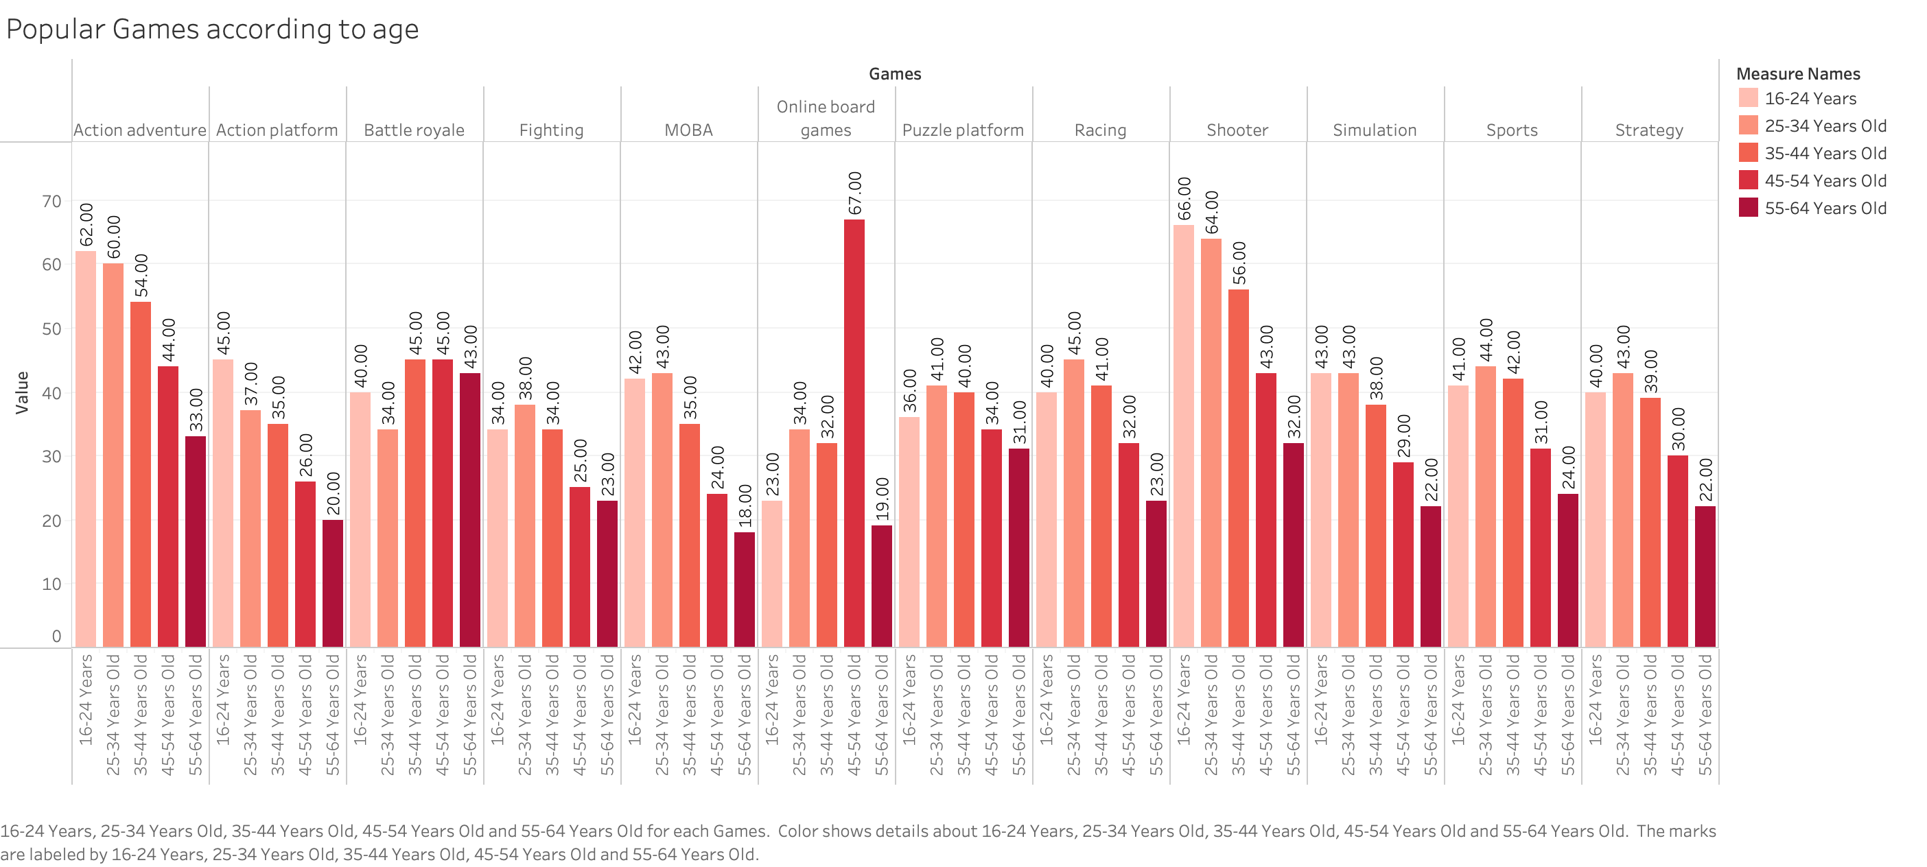

Slide 3
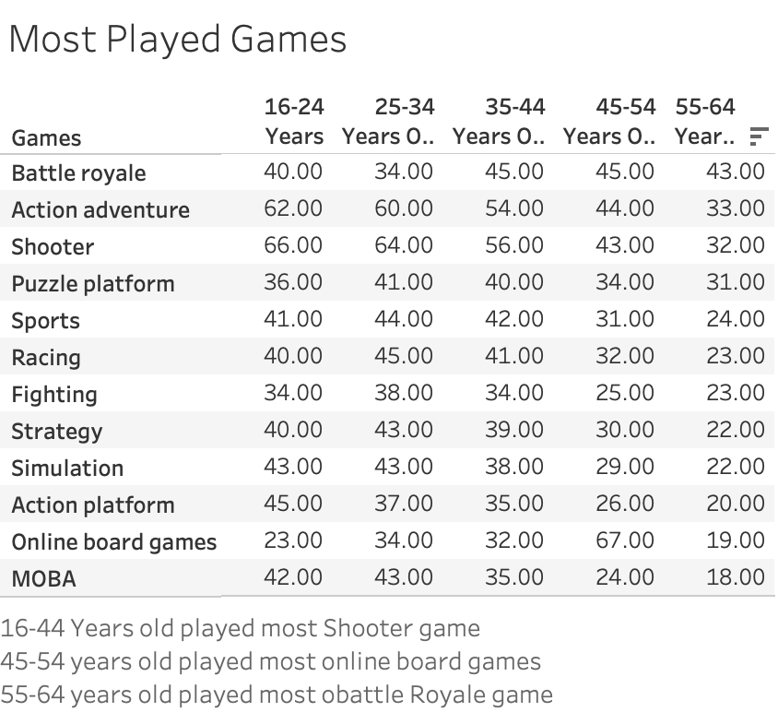

Slide 4
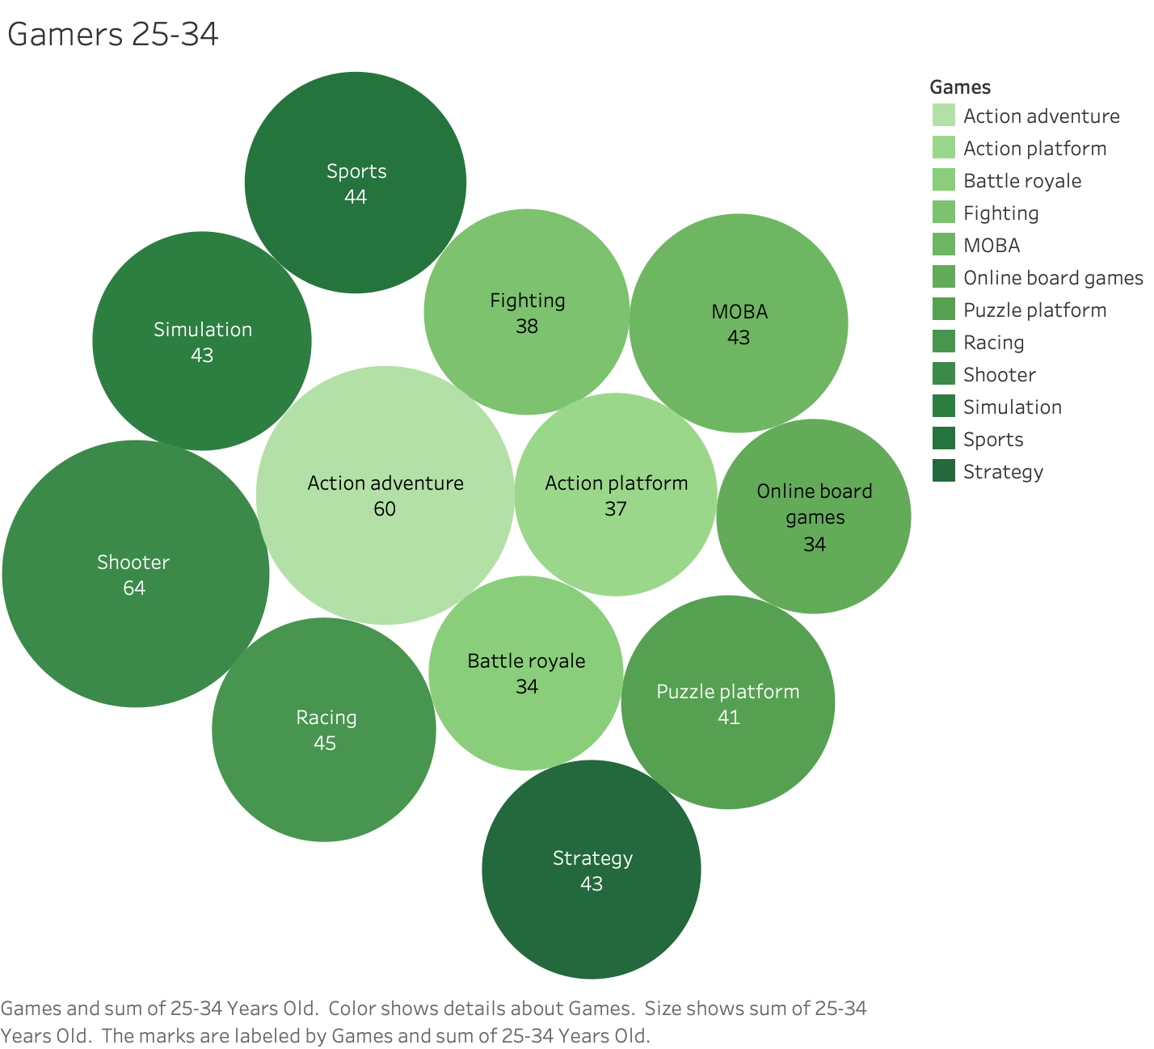

Slide 5
